Slide 1




ClimateWins
////
Kristina Noriega
ClimateWins: Using Machine Learning to Predict European Weather Patterns
Machine Learning with Python
2025
Notes:
Hello, and thank you for taking the time to review my ClimateWins project.
My name is Kristina Noriega, and today I’ll be presenting the results of my machine learning analysis focused on European weather data.
The goal of this project was to explore how machine learning can help ClimateWins better understand changing weather patterns, identify anomalies, and support long-term climate planning and safety decisions across Europe.

Slide 2
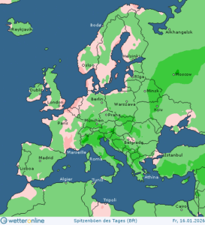
ClimateWins
////
Project Objectives & Scope
Identify weather patterns outside regional norms
Determine whether unusual weather events are increasing
Explore future weather conditions over 25–50 years
Support decisions about long-term climate safety in Europe
ClimateWins: Machine Learning for Weather Prediction
Notes:
ClimateWins is interested in understanding how weather patterns are changing over time and whether machine learning can improve forecasting and risk assessment.
Specifically, this project focused on four key objectives.
First, identifying weather patterns that fall outside of regional norms.
Second, determining whether unusual weather events are becoming more frequent.
Third, exploring possible future weather conditions over the next twenty-five to fifty years.
And finally, supporting decisions about the safest places for people to live in Europe as climate conditions continue to change.
To address these goals, I explored multiple machine learning approaches rather than relying on a single model.

Slide 3

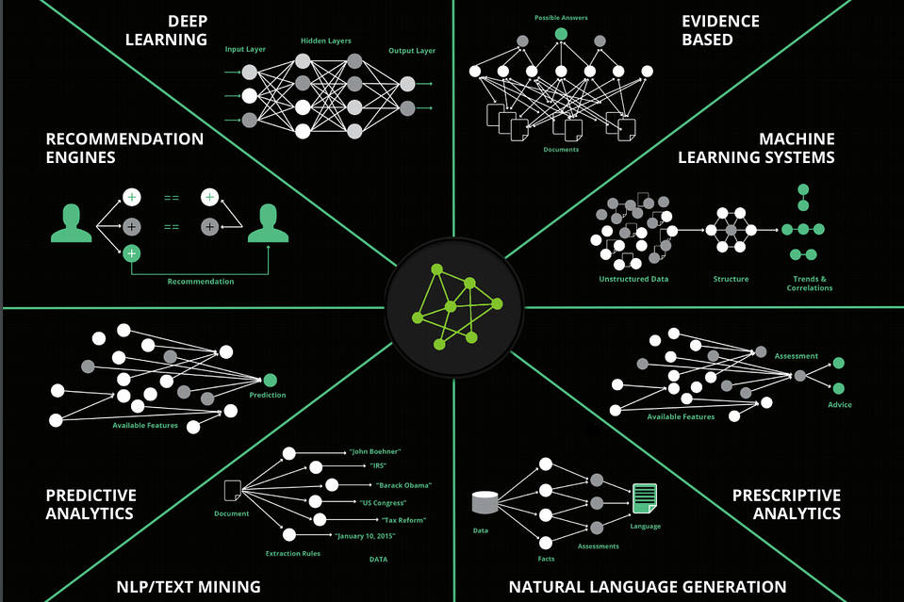
ClimateWins
////
1
Methods: Unsupervised Learning (PCA, clustering), Deep Learning (CNN), Random Forest, and Generative Models (GANs).
Machine Learning Approaches Explored
Notes:
Several different machine learning methods were explored during this project.
I began with unsupervised learning techniques, including principal component analysis and clustering, to explore patterns in the data without predefined labels.
I then implemented supervised learning approaches, including Random Forest models, to understand feature importance and improve predictive accuracy.
Deep learning methods, specifically convolutional neural networks, were explored to evaluate whether more complex models could better classify extreme weather conditions.
Finally, I explored Generative Adversarial Networks conceptually as a possible future approach for simulating rare or extreme weather scenarios.

Slide 4
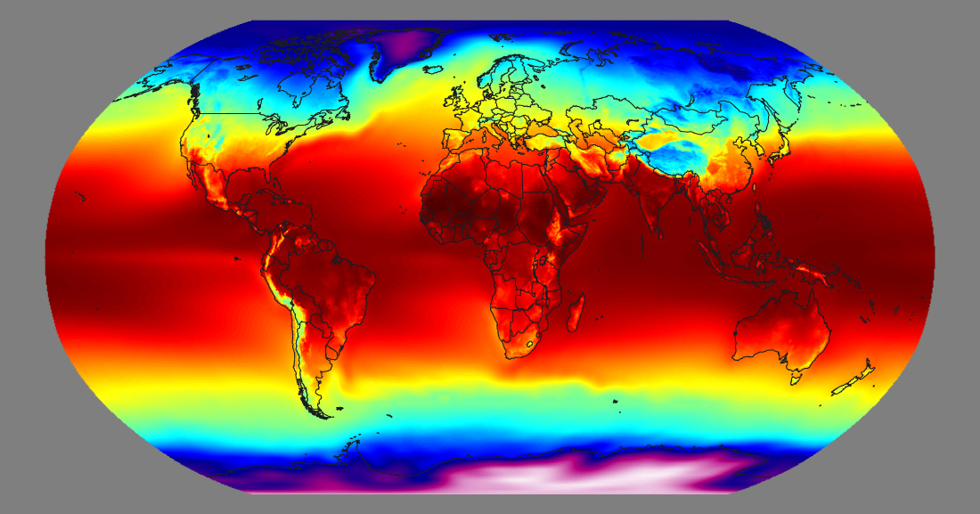
ClimateWins
////
2
Data Used: Historical European weather observations including temperature, precipitation, radiation, and sunshine.
Data Used and Additional Data Needed
3
Additional Data Needed: Climate projections, geographic data, population/infrastructure data, and extreme weather records.
Notes:
The primary dataset used in this project consisted of historical European weather observations, including temperature, precipitation, radiation, and sunshine measures across multiple stations.
While this dataset was sufficient for exploratory analysis and model training, additional data would be required for ClimateWins to fully achieve its long-term goals.
This would include climate projection data, geographic and elevation information, population density and infrastructure data, and detailed records of extreme weather events.
Combining these datasets would allow ClimateWins to connect weather predictions to real-world human impact and safety planning.

Slide 5
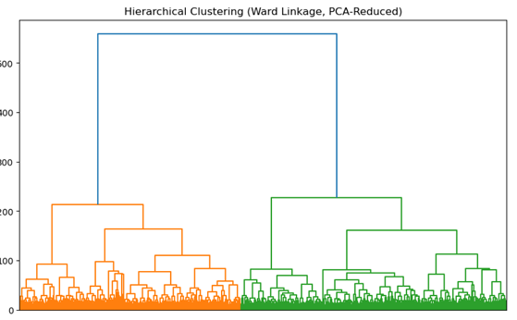
ClimateWins
Thought Experiment
One: Pattern Discovery
////
Question:
Can unsupervised learning identify emerging or shifting weather patterns in Europe before they are obvious to humans?
Machine Learning Method:
• Principal Component Analysis (PCA)
• Clustering (e.g., k-means or hierarchical clustering)
Approach:
• Reduce complex weather variables into core dimensions
• Group weather observations based on similarity rather than labels
• Track whether clusters shift over time
Value to ClimateWins:
• Early detection of climate anomalies
• Identification of regions moving outside historical norms
• Supports long-term climate monitoring and risk assessment
Figure: Hierarchical clustering of PCA-reduced European weather data, showing distinct groupings of similar weather patterns without predefined labels.
Notes:
The first thought experiment explores whether unsupervised learning can identify emerging climate anomalies before they are obvious to human analysts.
Using techniques such as PCA and clustering, historical weather data can be grouped into patterns based on similarity rather than predefined categories.
If these clusters begin to shift over time, it could indicate that regional climates are changing in meaningful ways.
This approach directly supports ClimateWins’ goal of identifying unusual weather patterns and detecting early signs of climate change.

Slide 6
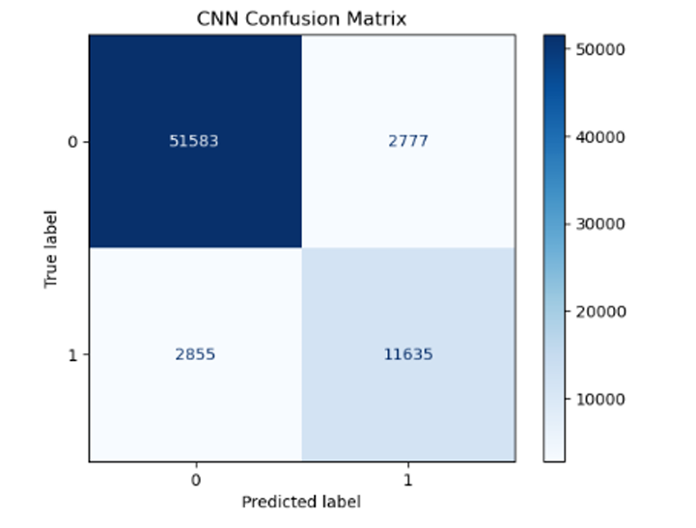
ClimateWins
////
Thought Experiment Two:
Predicting Extreme Weather
Question:
Can deep learning models improve prediction of extreme or rare weather events?
Machine Learning Method:
• Convolutional Neural Networks (CNN)
Approach:
• Learn complex, non-linear relationships in weather data
• Classify weather observations into normal vs. extreme conditions
• Improve detection of rare but high-impact events
Value to ClimateWins:
• Earlier identification of extreme weather risks
• Improved preparedness and response planning
• Supports climate-related safety decisions
Figure: Confusion matrix showing CNN classification performance
for extreme versus non-extreme weather conditions.
Notes:
The second thought experiment focuses on predicting extreme weather events using deep learning.
Convolutional neural networks were explored to determine whether they could better classify rare or extreme conditions compared to traditional models.
Extreme weather events are often complex and nonlinear, which makes them difficult to detect using simpler approaches.
If successful, this method could help ClimateWins improve early warning systems and better prepare for high-risk weather scenarios.

Slide 7
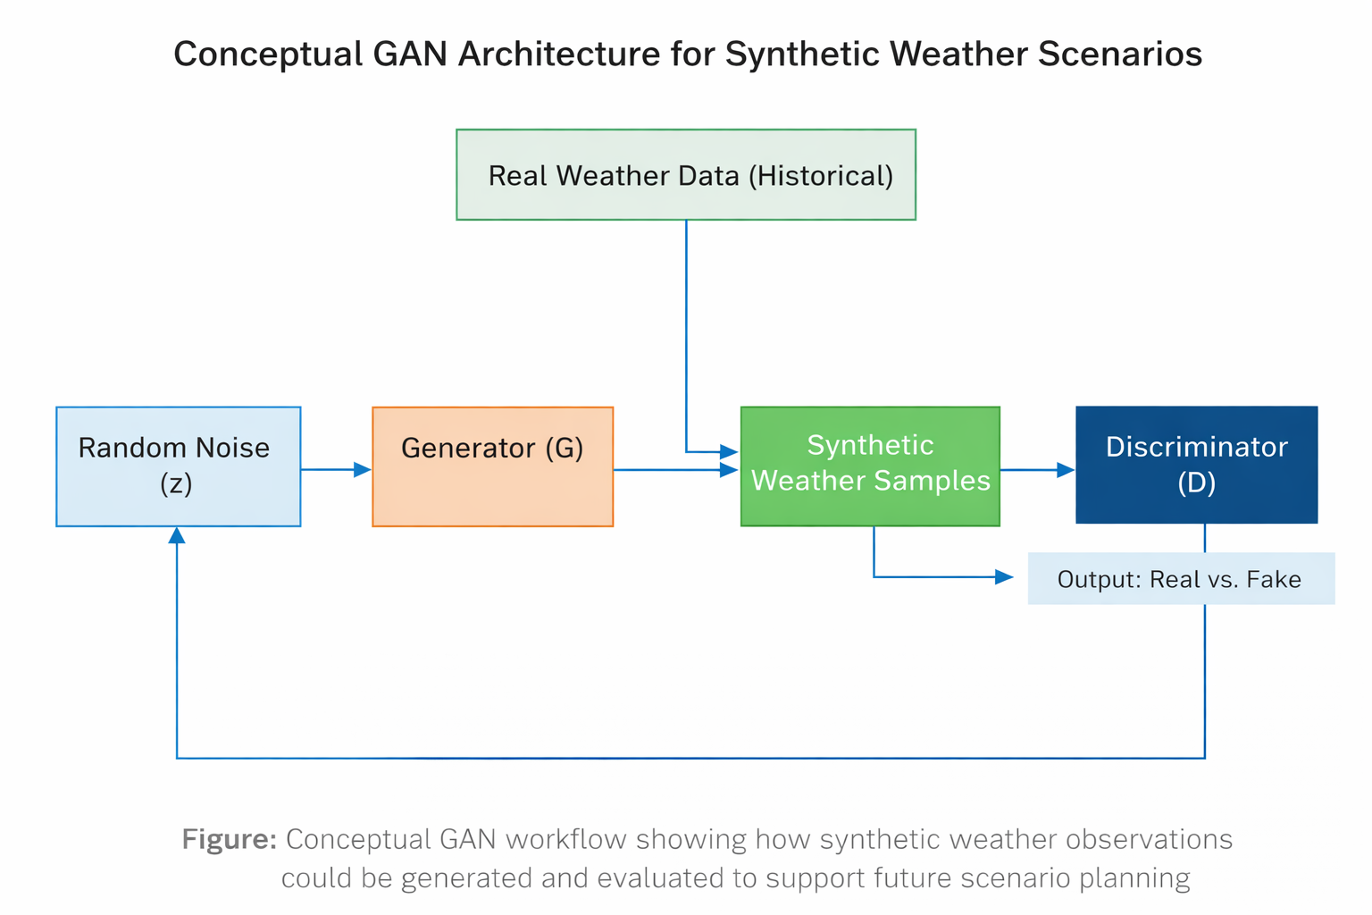
ClimateWins
////
Thought Experiment Three:
Simulating Future Scenarios
Question:
Can synthetic data generation help simulate future or rare weather scenarios?
Machine Learning Method:
• Generative Adversarial Networks (GANs)
Approach:
• Learn distributions from historical weather data
• Generate realistic synthetic weather observations
• Augment limited extreme-weather datasets
Value to ClimateWins:
• Exploration of future climate possibilities
• Improved modeling of rare or unseen events
• Supports long-term climate risk planning
Notes:
The third thought experiment looks toward the future and explores the use of generative models.
Generative Adversarial Networks, or GANs, could potentially be used to simulate realistic future weather scenarios based on historical trends.
This would be especially valuable for rare events where limited data exists.
While this approach is still experimental and would require careful validation, it represents a promising long-term strategy for ClimateWins as computational resources and climate data continue to expand.

Slide 8
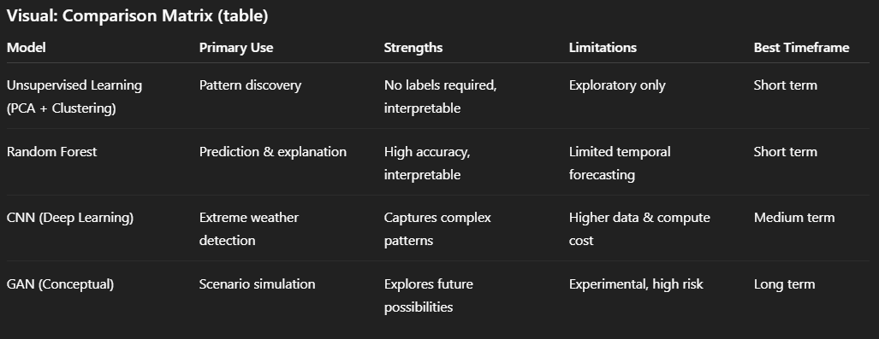
ClimateWins
Model Applications & Comparison
////
Comparison: Random Forest is interpretable and cost-effective. CNNs offer high predictive power but are more complex. GANs are experimental with high future potential.
Unsupervised learning can discover emerging climate anomalies. Deep Learning (CNNs) can predict complex extreme weather events. GANs show potential for simulating future scenarios.
Notes:
Each machine learning approach explored in this project offers different strengths.
Random Forest models are highly interpretable, cost-effective, and well-suited for stakeholder communication.
Deep learning models, such as CNNs, offer improved predictive power but require more data and computational resources.
GANs represent a high-risk, high-reward approach that may be more appropriate for future research rather than immediate deployment.
Selecting the right model depends on balancing performance, transparency, and feasibility

Slide 9
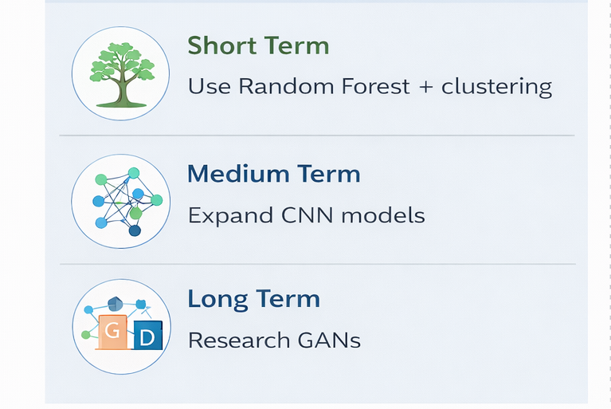
Recommendations and Next Steps
ClimateWins
////
Notes:
Based on the results of this project, several recommendations can be made.
In the short term, ClimateWins should focus on Random Forest models combined with clustering techniques to identify anomalies and explain results clearly to stakeholders.
In the medium term, expanding deep learning models could improve the prediction of extreme weather events.
In the long term, further research into generative models may support future climate scenario planning.
Next steps include integrating additional datasets, testing models on projected climate data, and refining evaluation metrics based on ClimateWins’ operational goals.

Slide 10


ClimateWins
////
Thank You
GitHub: ducatifamily/ClimateWins-Weather-Prediction1: Machine learning analysis of European weather data for ClimateWins
Kristina Noriega | Machine Learning with Python
7
Notes:
Thank you for your time and attention.
This project demonstrates how machine learning can support ClimateWins in understanding climate change, preparing for future risks, and making informed, data-driven decisions.
I’m happy to answer any questions or discuss these approaches further.

